Slide 1
Product Analyst Case Study
Brandon Bullard

Slide 2

Outline
Data processing and cleaning
Exploratory data analysis
Relationships and insights
Recommendations
Limitations and future work

Slide 3
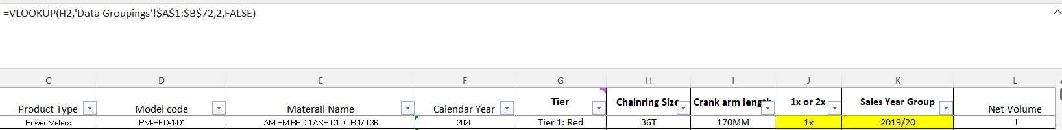
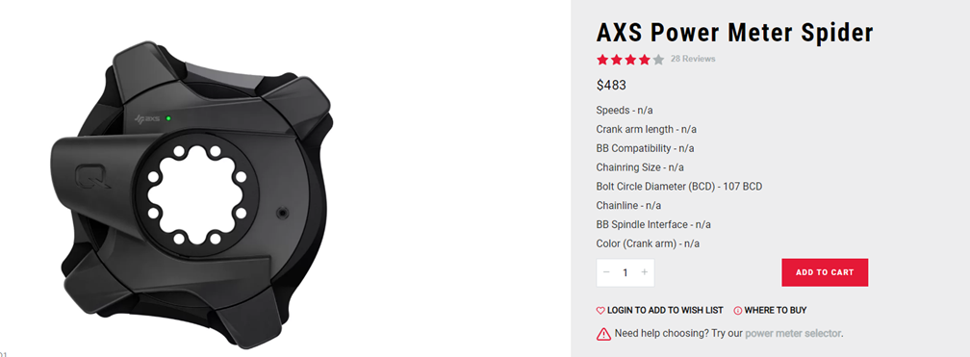
Data Processing and Cleaning
In Excel, impute the missing data by running a vlookup against key.
Remove observations with no rings and no arms. No ring acceptable for crank arm analysis, no arm acceptable for chainring. However, this data pollutes both.

Slide 4
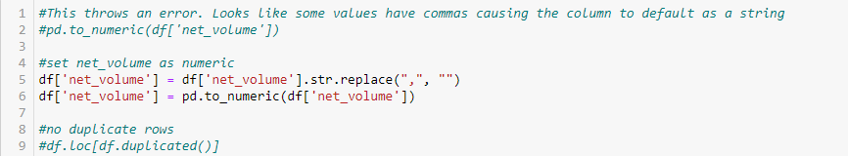
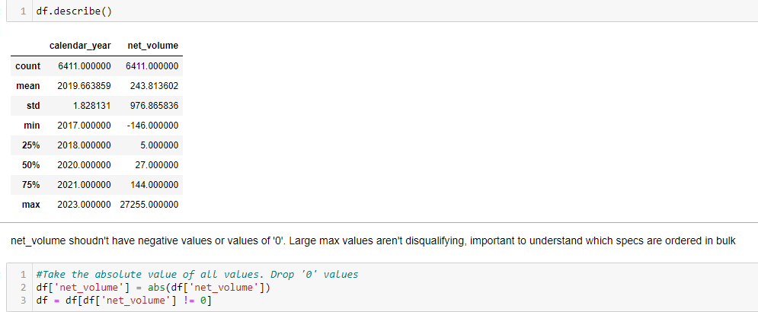
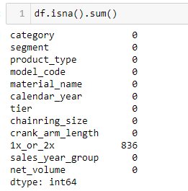
Data Processing and Cleaning
Convert string to numeric
Take absolute value of negative values, remove ‘0’ values
Remaining null values for 1x/2x are crank arms (836)

Slide 5
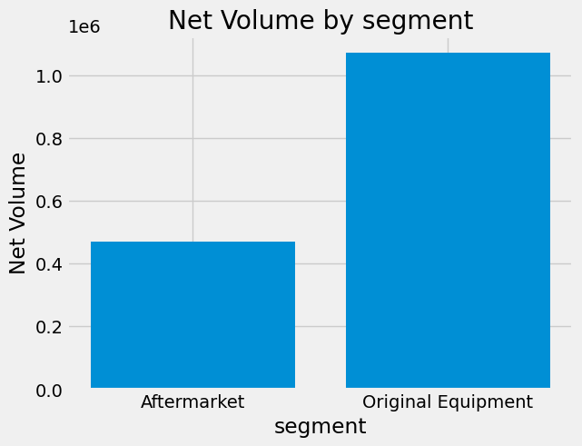
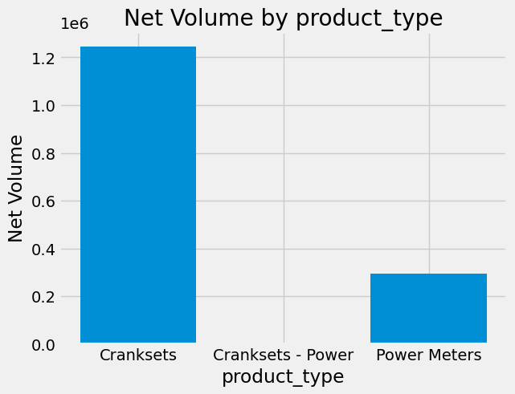
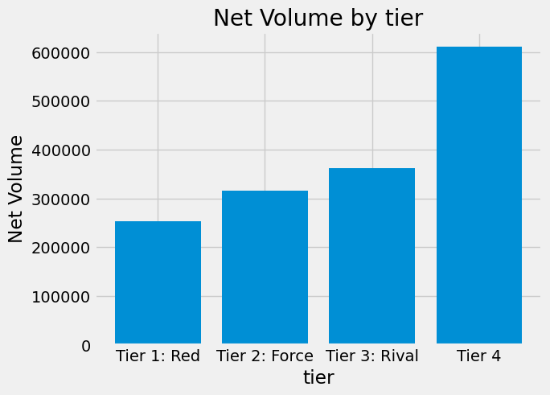
Exploratory Data Analysis
Given the wide dataset, plotting each categorical variable against ‘net_volume’ helps build understanding of the data.

Slide 6
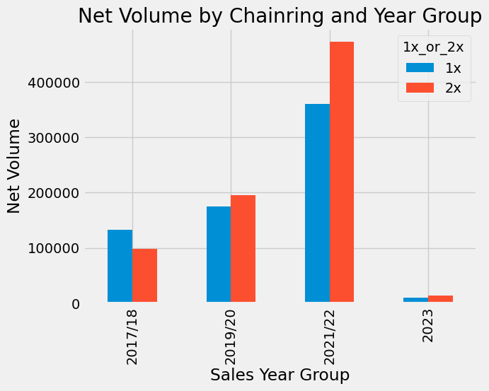
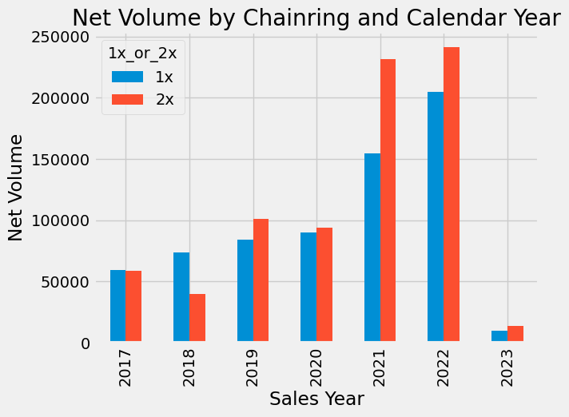
Exploratory Data Analysis
What level of aggregation should be used? Sales Year Group Pro/Con
Pro: Bicycle industry is highly seasonal. Using sales year group allows for long run impacts to be assessed.
Con: Combining years can hide some information. EX: 2019 “normal” sales year--combined with 2020 can dilute major trends.

Slide 7
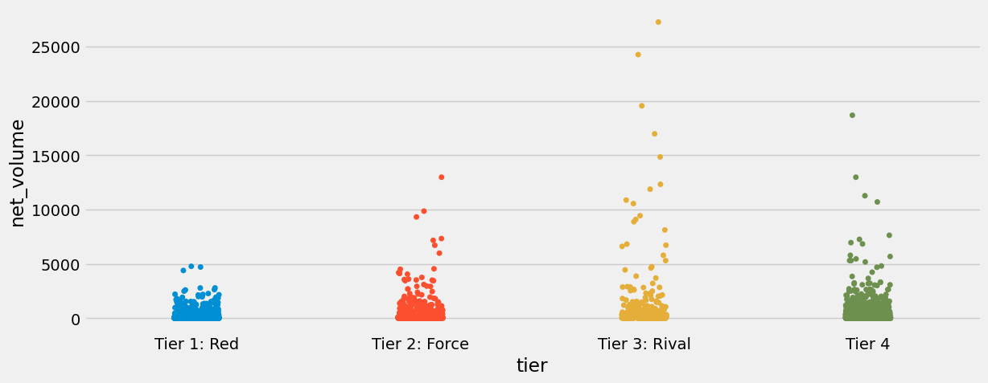
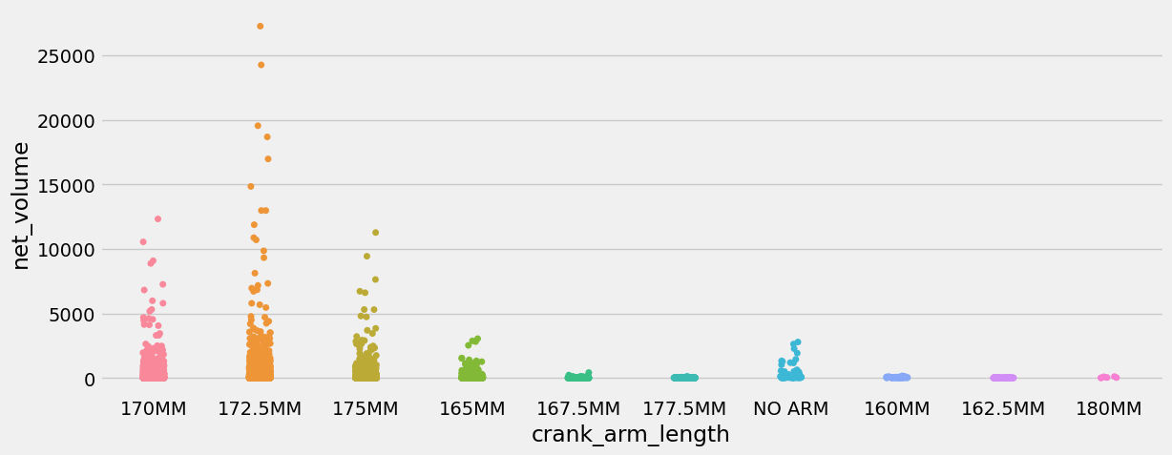
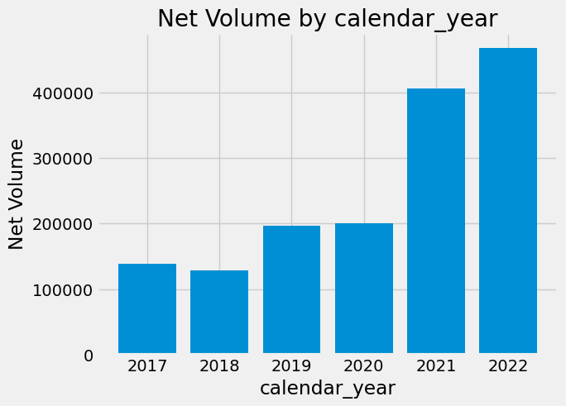
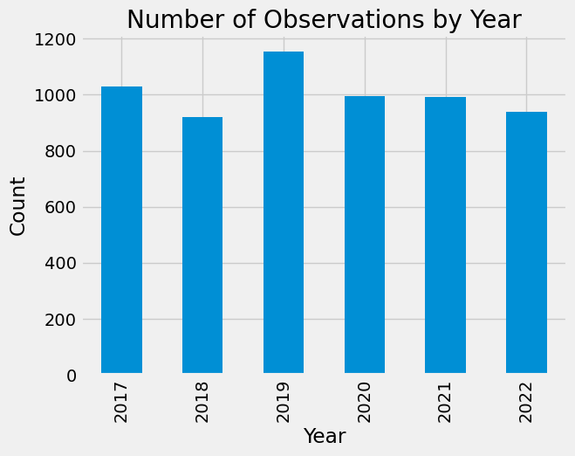
Exploratory Data Analysis
The distribution of net_volume is heavily right-skewed. Large volume orders (outliers) are mostly concentrated in tiers 3 + 4.
Net volume per order is increasing. Count of orders is stable around ~1800.

Slide 8
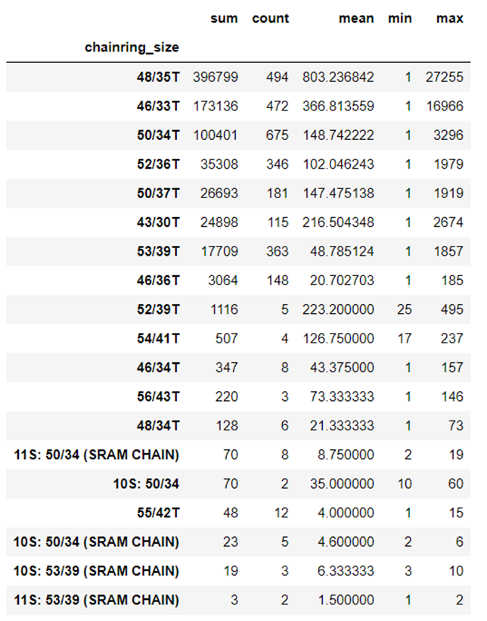
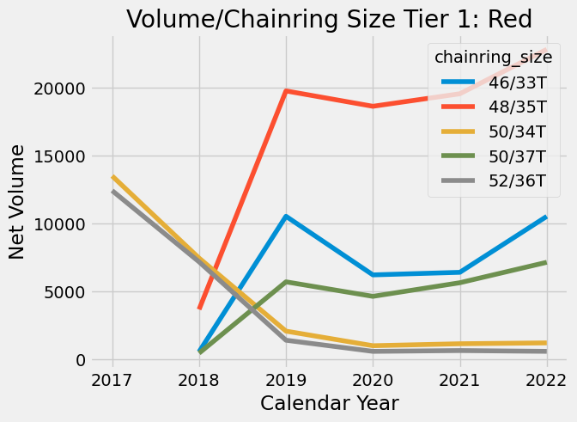
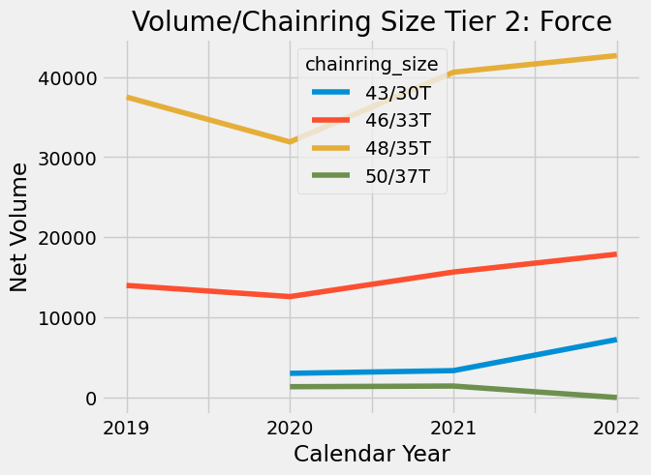
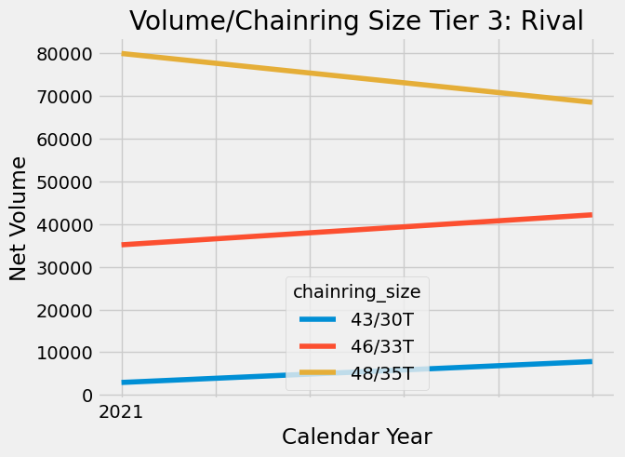
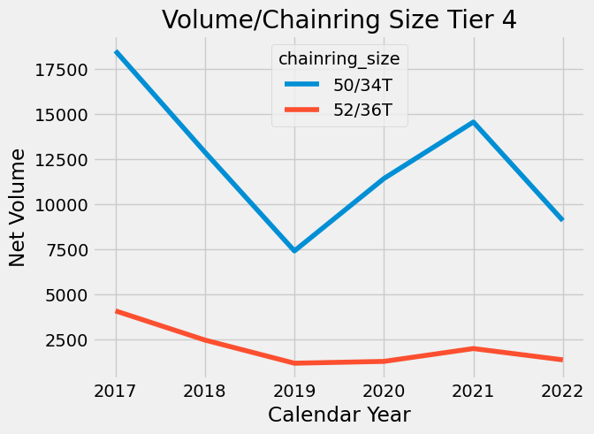
Relationships and Insights: 2x Chainring

Slide 9
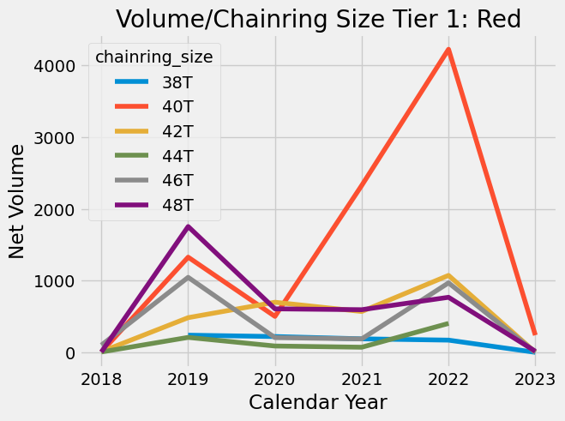
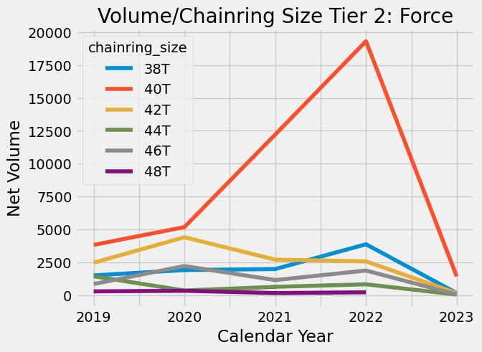
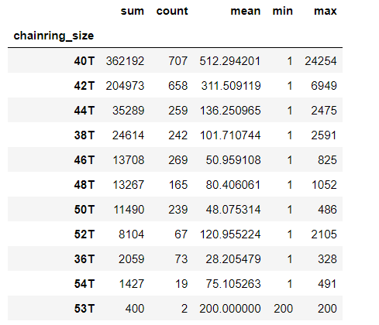
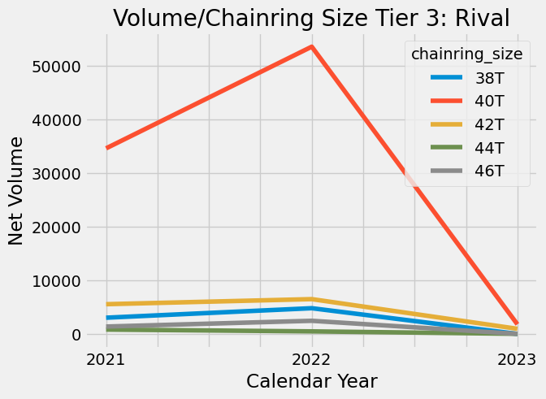
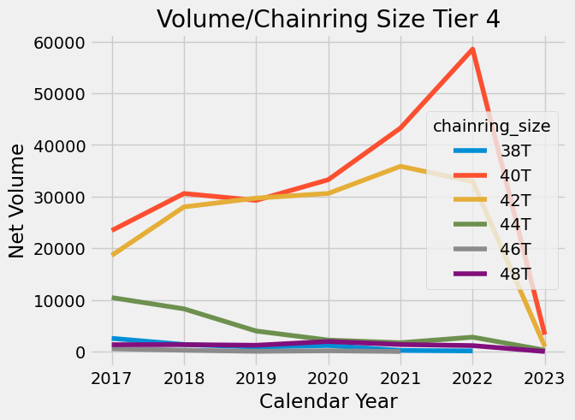
Relationships and Insights: 1x Chainring

Slide 10
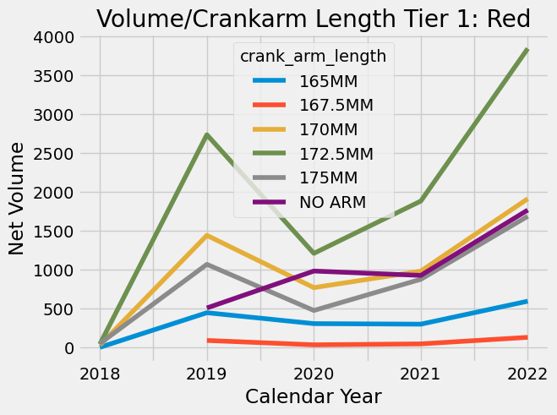
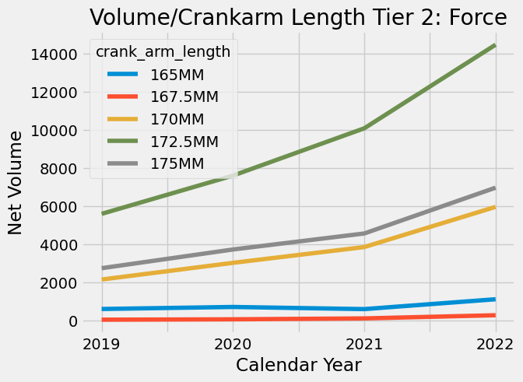
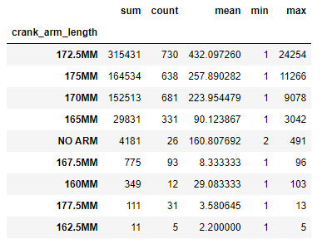
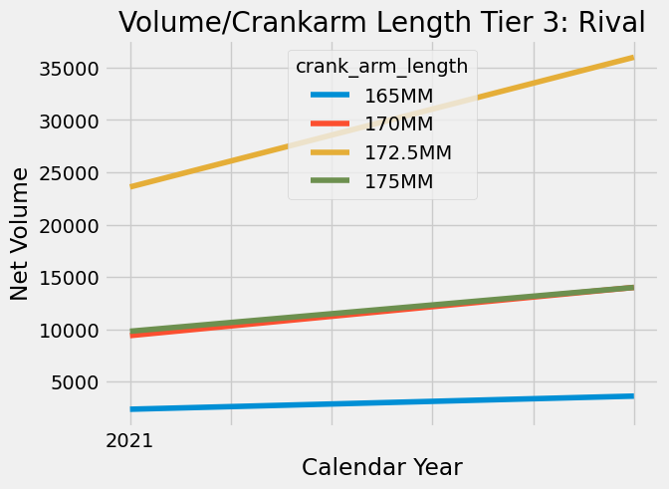
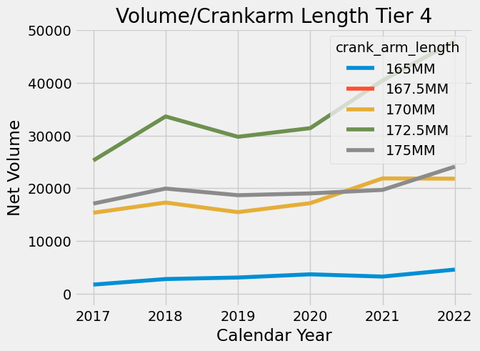
Relationships and Insights: Crank arm Length

Slide 11
Recommendations

Slide 12
Limitations and Future Work
Road segment is the only category included. Chainrings + crankarms are shared across categories.
FW: Get data across categories
Sales data is not necessarily reflective of consumer demand. Given simultaneous supply and demand shocks after 2020, net volume is likely skewed towards higher margin/priced groupsets.
FW: Understand if and how tier 4 is underserved (external data/customers)
Production decisions should be made in confluence with more stakeholders
FW: Understand customer priorities, especially for existing large volume customers (> 5000 net_volume customers)
FW: Involve more functional groups to prioritization table. (part risk, customer survey data)

